Slide 1
MOBILE TESTING
Mobile Applications
Applications that are developed to be used in hand held devices or compact devices like smartphones, tablets, etc are called as Mobile Applications.
Mobile applications frequently serve to provide users with similar services to those accessed on PCs.
Introduction to Mobile Testing
Mobile device testing is the process by which mobile apps are tested for functionality, usability, and consistency. Testing app on mobile devices can be done manually or with automation.
Types of Mobile Apps : 1. Native Apps 2. Web Apps 3. Hybrid Apps 4. Cross-Platform Apps 5. Progressive Web Apps (PWA)

Slide 2
Native Apps : These are the applications which are been developed and complied using specific programming language for specific platform and they are also built using specific integrated development environment. Ex : What’s app, Gaming app, Facebook, Gmail, Twitter Benefits of Native apps : Fast and Responsive, Efficient, Provides access to full feature set of devices, Works offline. Drawbacks : Development cost, Code Reusage, Takes more time. Web Apps : Mobile web apps are device-neutral and it is mobile friendly websites which are built using HTML 5, CSS 3 and Java script. These web sites can be reached by typing a specific URL into your mobile browsers. Some web apps are built specifically as mobile websites where you can access mobile websites using m.domain.com. (www.facebook.com – m.facebook.com) Ex: Facebook, Gmail Benefits of Web Apps : Development cost, Easy Access, No installation needed. Drawbacks: It does not work offline, Less access to device features like Camera, GPS, Sensor, Longer time to develop

Slide 3
Hybrid Apps : These are the applications built with combination of Native and Web apps. Hybrid apps is a program that is built using HTML 5, CSS 3 , Java Script and it is wrapped in a native container which allows it to use the functionality of microphone , camera , push notification , calendar.
Ex : Instagram , Twitter, Amazon, Cricbuzz, Evernote.
Benefits of Hybrid apps : Development cost is less, code reusage
Drawbacks : Slower performance than Native apps , more expensive than web apps.
Cross-Platform Apps : It is the process of creating mobile apps that can be deployed or published on multiple platforms using single code base.
Ex: Walmart, Facebook
Progressive Web Apps : These are extension of website that you can save on your computer system or devices and use like an app. PWA use web browser API’S and functionalities to bring a native app like experience across devices.
Ex: Telegram , Twitter

Slide 4
Types of Web designs layouts
Adaptive : It is characterized by having defined layouts for different resolutions, within each layout resizing the window does not change the layout.
Liquid : It is characterized by scaling the width of parts of the design relative to the window. It tends to fail when the window is much smaller or much larger than it was originally designed for.
Static : Static layouts are the traditional web : one design that sits in the centre of the page and requires horizontal scrolling if the window is too small for it.
Responsive : It is characterized by having defined layout for different resolutions within each layout , the design is liquid and resizes the width of elements relative to changing windows size.

Slide 5
Mobile software Development Life Cycle
Idea
Prototype
Graphic Design
App Development
Beta Release
Launch
Feature Set

Slide 6
Mobile Software Development Life Cycle (MSDLC)
The lifecycle of mobile development is similar to SDLC of web or desktop applications. Here we have 6 major stages of the process,
They are as follows,
Inception – Requirement / System Analysis
Design – UI & UX
Development – Coding / UI Coding
Stabilization – Testing
Deployment / Distribution
Maintenance

Slide 7
Requirement / System Analysis
All software applications start with an idea. This idea is usually refined into a solid requirement for an real world application
This idea can be of customers/ from developers or company business team
Requirement document and used cases are created. Target mobile platforms are also identified
Competitive Advantage, Infrastructure Integration, Value, Form Factor are discussed
Design Stage
Once you have a good idea of what it is to be designed, next step is to solve the User Experience
The feasibility on target mobile platforms are identified
This stage concentrates on the software architecture of the application
The core functionalities are identified and are broken down into modules. Later, integration of these modules are also defined
UI/UX designs, Wire frames and Style guides are created and reviewed by customers

Slide 8
Development Stage
In this stage application is coded
Development process can be done in two stages
1.Coding for functionality requirement and
2.Coding for UI requirements
First core functionalities are coded and parallel development can be done for multiple modulus and then modules are integrated
Prototyping:- 1.The app is in proof of concept(POC) and only core functionality or specific parts are working
2.The prototype are tested and sent to the client for feedback and feedback changes are implemented
3.The development , prototyping and testing the prototypes are repeated until final prototype is ready

Slide 9
Stabilization Stage
Stabilization is the process of finding out the bugs in the app
Typically applications go into prototype ,alpha ,beta ,release candidate/production stages
Prototype: The app is still in proof-of-concept phase and only core functionalities or specific parts of the application are working major bugs are present
Alpha : core functionality is generally code complete. Major bugs are still present
Beta : most functionality is now complete and has had at least light testing and bug fixing. Major issues may still be present
Release Candidate/production : All functionality is complete and tested.

Slide 10
Distribution/Deployment Stage:
It is final stage of development process after final feedback obtained from client the app is really ready for deployment
We can have enterprise deployment-only meant for internal distribution within company for feedback . They can also have beta deployment
Then the application is uploaded to the appropriate application store
Maintenance Stage:
It is a continuous process
Feedback is collected from users and made inform of bug or improvement
New UI should be provided at regular intervals along with performance and security improvement

Slide 11
Types of mobile testing
Installation testing
Stand by testing
Interruption testing
Orientation testing
UI testing
Gesture testing
Compatibility testing
Cross platform testing
Geo location testing
Network testing

Slide 12
1. Installation testing : It is proses of to verify weather app installation go smoothly
2. Stand by testing : Here we will verify the UI of the application and behaviour of the application by putting the device stand by mode.
3. Interruption testing : It is a procedure where user purposefully interrupt the application by predefined process.
4.Orientation testing : Testing the different orientation like Portrait and landscape mode
5. UI testing : we check whether all the radio button, check box, Drop down box and verifying the graphical user interface of the application.
6. Gesture testing : Testing the gesture of the application like pinch-in, pinch-out, tap, double tap, swipe, slide.
7. Compatibility : Verifying the application in the different devices, OS versions, RAM size, Battery capacity, screen density, screen size.
8. Cross Platform testing : Cross checking the application in different platform like iOS and android.
9.Network testing : Testing the application in different network speed like 2G,3G,4G and WIFI.
10.Geo Location testing : Testing the application for various geo graphical locations.

Slide 13
ADB COMMANDS
ADB stands for "Android Debug Bridge".
ADB is a versatile command tool which works on Android devices for debugging purpose.
ADB is used only for Android devices not for ios devices.
ADB runs on TCP port no 5037.
ADB is used by both Developers and testers.
ADB is used to communicate with a device or emulator where we can use adb for installing the build, recording the screen, and taking logs etc.
ADB is a client-server architecture where it includes 3 components:
1. Client: -Client is used to send commands.
-Client configuration will be done on Development system.
2. Server: -Server is used to send commands.
-Server configuration will be done on Development system.
3. Daemon: -It runs the commands in the device.
-Daemon configuration will be done in device.

Slide 14
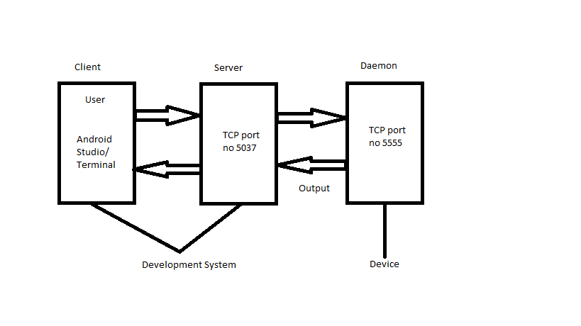
ADB ARCHITECTURE

Slide 15
ADB Commands
adb version // (To check adb version)
adb devices // (To check devices connected)
adb start-server // (To start adb server)
adb kill-server // (To kill the server)
adb install <path of the .APK file> // (To install app/.apk file)
adb install –r <path of the .APK file> // (To replace or update)
adb -s <serial no of specific device> install <path of the .APK file> // (To perform actions on specific device when there are multiple devices)
adb -e install <path of the .APK file> // (To perform actions on emulator when there are multiple devices)
adb -d install <path of the .APK file> // (To perform actions on device when it is connected to 1 device and 1 emulator)
adb uninstall <package name> // (To uninstall app)

Slide 16
adb shell screenrecord /sdcard/filename.mp4 --time-limit30 // (To take screenrecord for specific time)
adb logcat -c // (To clear previous logs)
adb logcat > filename.txt // (To get logs)
adb pull /sdcard/filename <system path> // (To pull file from system to device)
adb push filename /sdcard/ // (To push file from device to system)
adb logcat <package name> > filename.txt // (To get log for particular application)
adb shell screencap /sdcard/filename.png // (To take screenshot)
adb shell screenrecord /sdcard/filename.mp4 // (To take screenrecord)
adb shell pm list packages // (To get list of package names)
adb shell dumpsys > filename.txt // (To get logs of system or device)
adb uninstall -k <package name> // (To uninstall app without clearing/loosing data and cache in device)
To perform keyevents use- adb shell input keyevent <number>

Slide 17
Gaming Development Life Cycle(GDLC)
GDLC(Game Development Life Cycle):
GDLC is similar to manual and mobile application testing.
Here we have to give a glitch-free and UI designs should be proper according to the requirement specifications.
In GDLC we have 10 stages:
1. Story/idea
2. Conceptual analysis
3. Game planning
4. Team building
5. Designing
6. Development
7. Testing
8. Pre-Production
9. Main-Production
10. Sales & marketing

Slide 18
1. Story/idea:
It is a type of requirement collection. Here we will be getting ideas from the customer & it represents just a piece of game. It’s a prototype of game. It is also called as game concept/story.
2. Conceptual analysis:
It is type of feasibility study, Here we analyse the requirement in depth. It is done before development starts. Here we should analyse.
Actual requirement
Pricing
Technical capabilities
Solutions
Skills & Scopes

Slide 19
3. Planning:
After grabbing all the requirements & studies we will plan for game development.
Blueprint, list of all the features, document, make chart.
Make list of task(Graphics, animations, sounds).
Time-scheduling, estimation.
Create document, test case, plans.
Care about rework & submit final bug free product.
4. Team building:
To start design & development we need team to make our concepts true. So we need members like designers, programmers, testers.

Slide 20
5. Concept design:
Designing prototype of actual idea/story. It is heart of any game. Design is proof to bring an idea to real.
It requires thinking, understanding, implementing, excecuting, behaviour, UI of the design.
Before starting development designer create document it is known as Game Design Document(GDD).
Game Design Document(GDD):
Title
Game genre
Game model
Goal
Topic of flow
Game flow.
Game logic

Slide 21
6. Developing:
Here we are developing the code according to the game logic.
7. Testing:
It is important part of GDLC. Testing & game design have the same weight in the any game/concept.
8. Pre-Production:
Before doing real production we make sure in pre-production by release the game to product for alpha/beta release for find out and track the real time bugs.
9. Production testing:
It is done once the application is released to market based on the user’s feedback the issue is fixed.
10 Sales & marketing:
Here marketing team will research to how we can improve our project & they will keep watching our competitor’s activity & new releases.

